Slide 1
Design Principles for Building a Mars Lander
Matthew Katterman

Slide 2

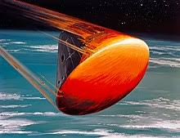
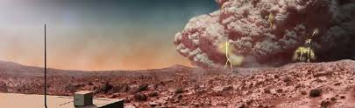
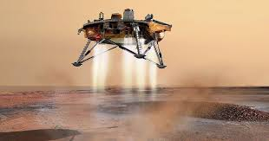
Difficulties of landing on Mars
Will construct your own lander with design to survive a landing
50 % of Mars Missions have crashed or been damaged.
2 Reasons for difficulty in landing:
1) Thin Atmosphere, 2) Weather Storms
Too heavy of payloads are difficult to land

Slide 3
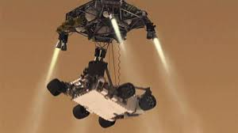
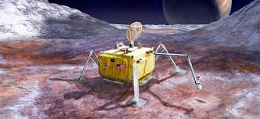

Other design considerations
air resistance (drag), cushioning (softening impact), stabilize (large base, balance it – not tip over)
Rover landings – utilize thrusters and parachute (creates drag – resistance).
Stabilize landings – wide base (legs extend out), balanced design (square spacecraft).
Cushioning materials – lessens impact (balloon like materials)

